Slide 1
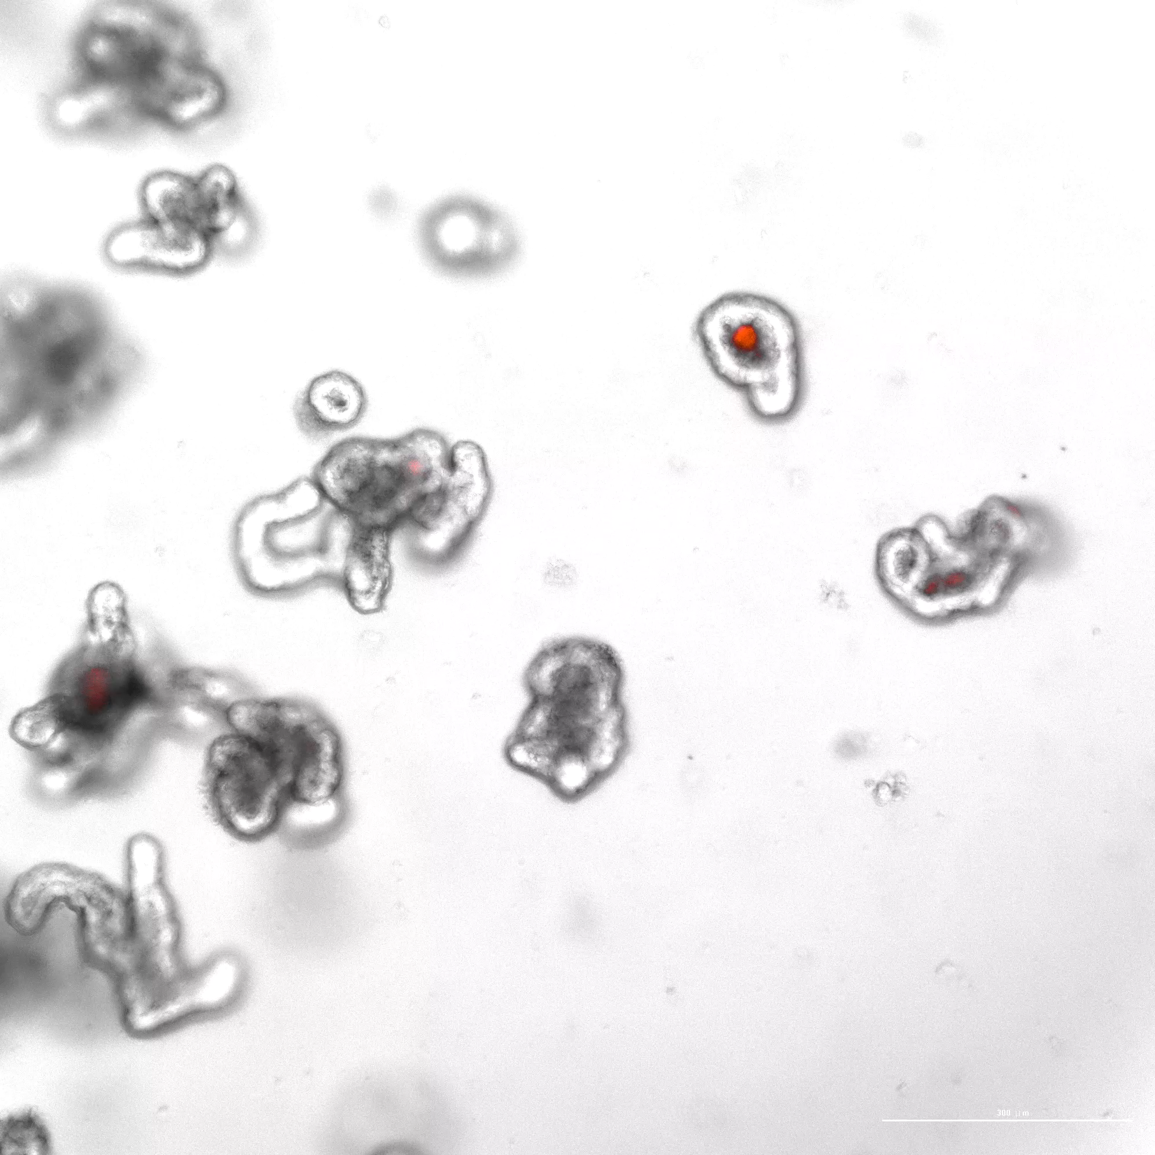
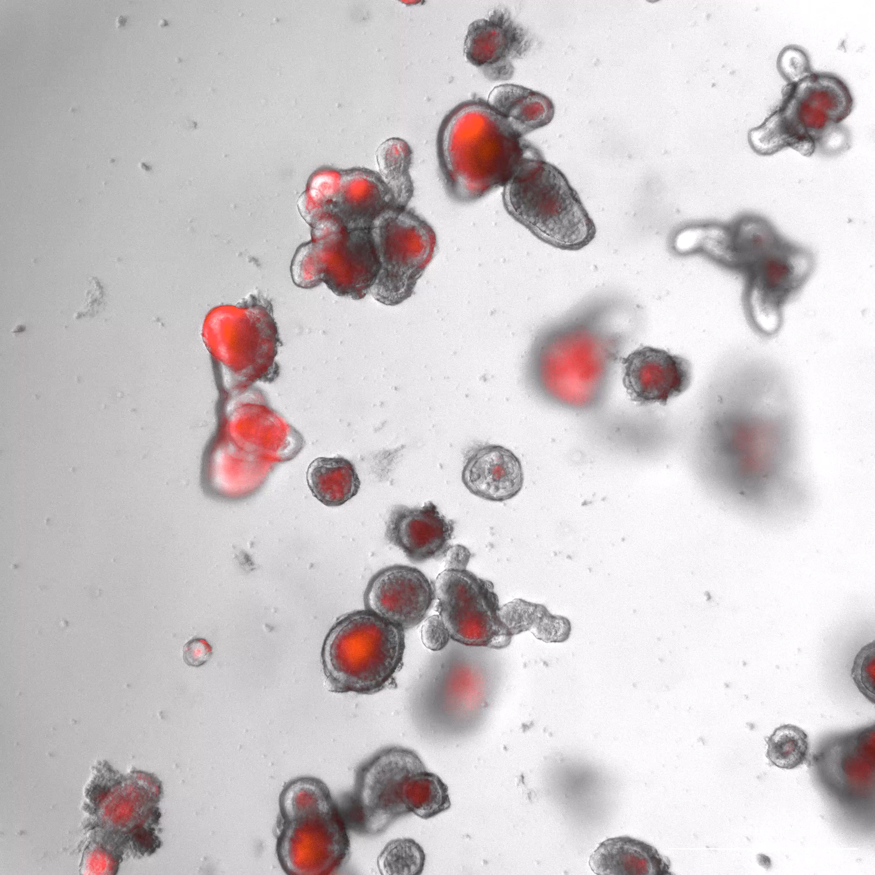
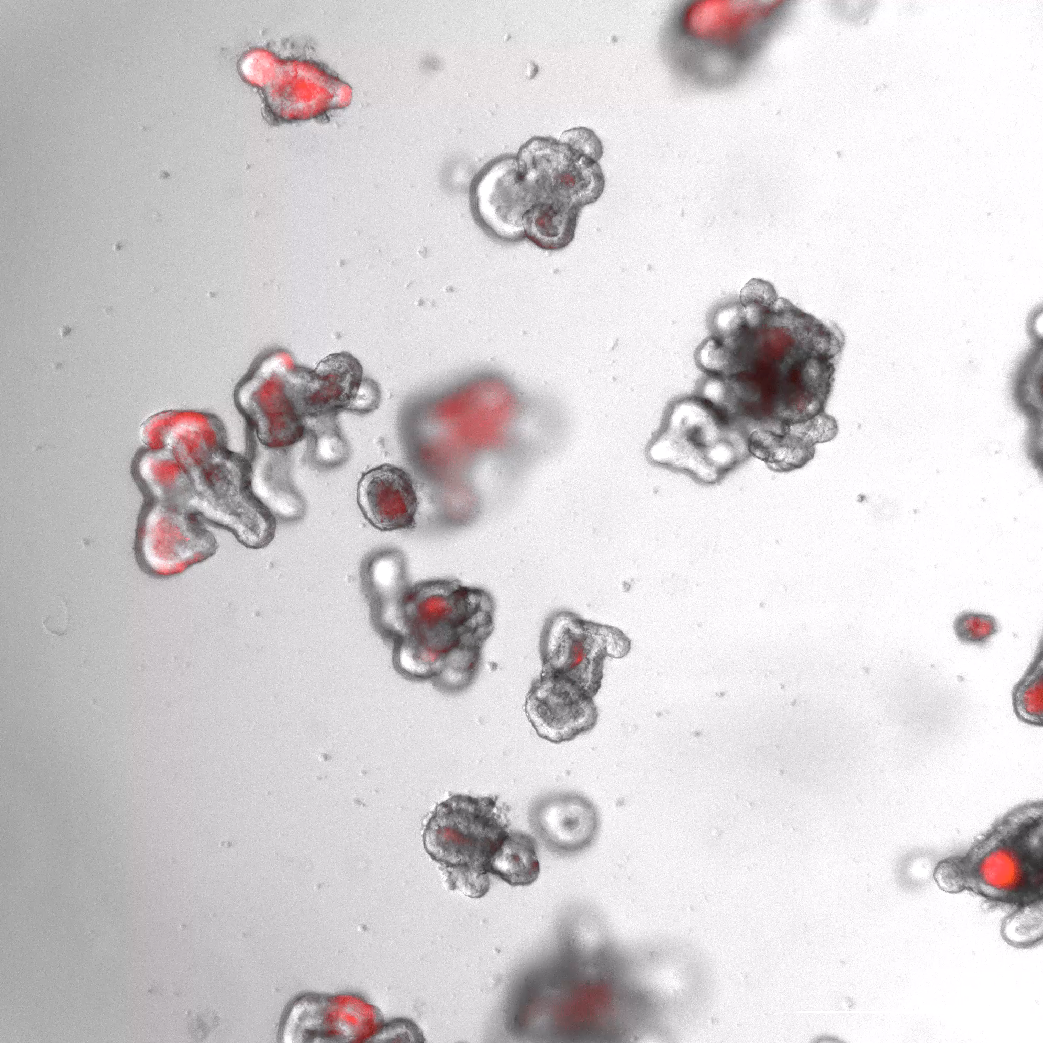
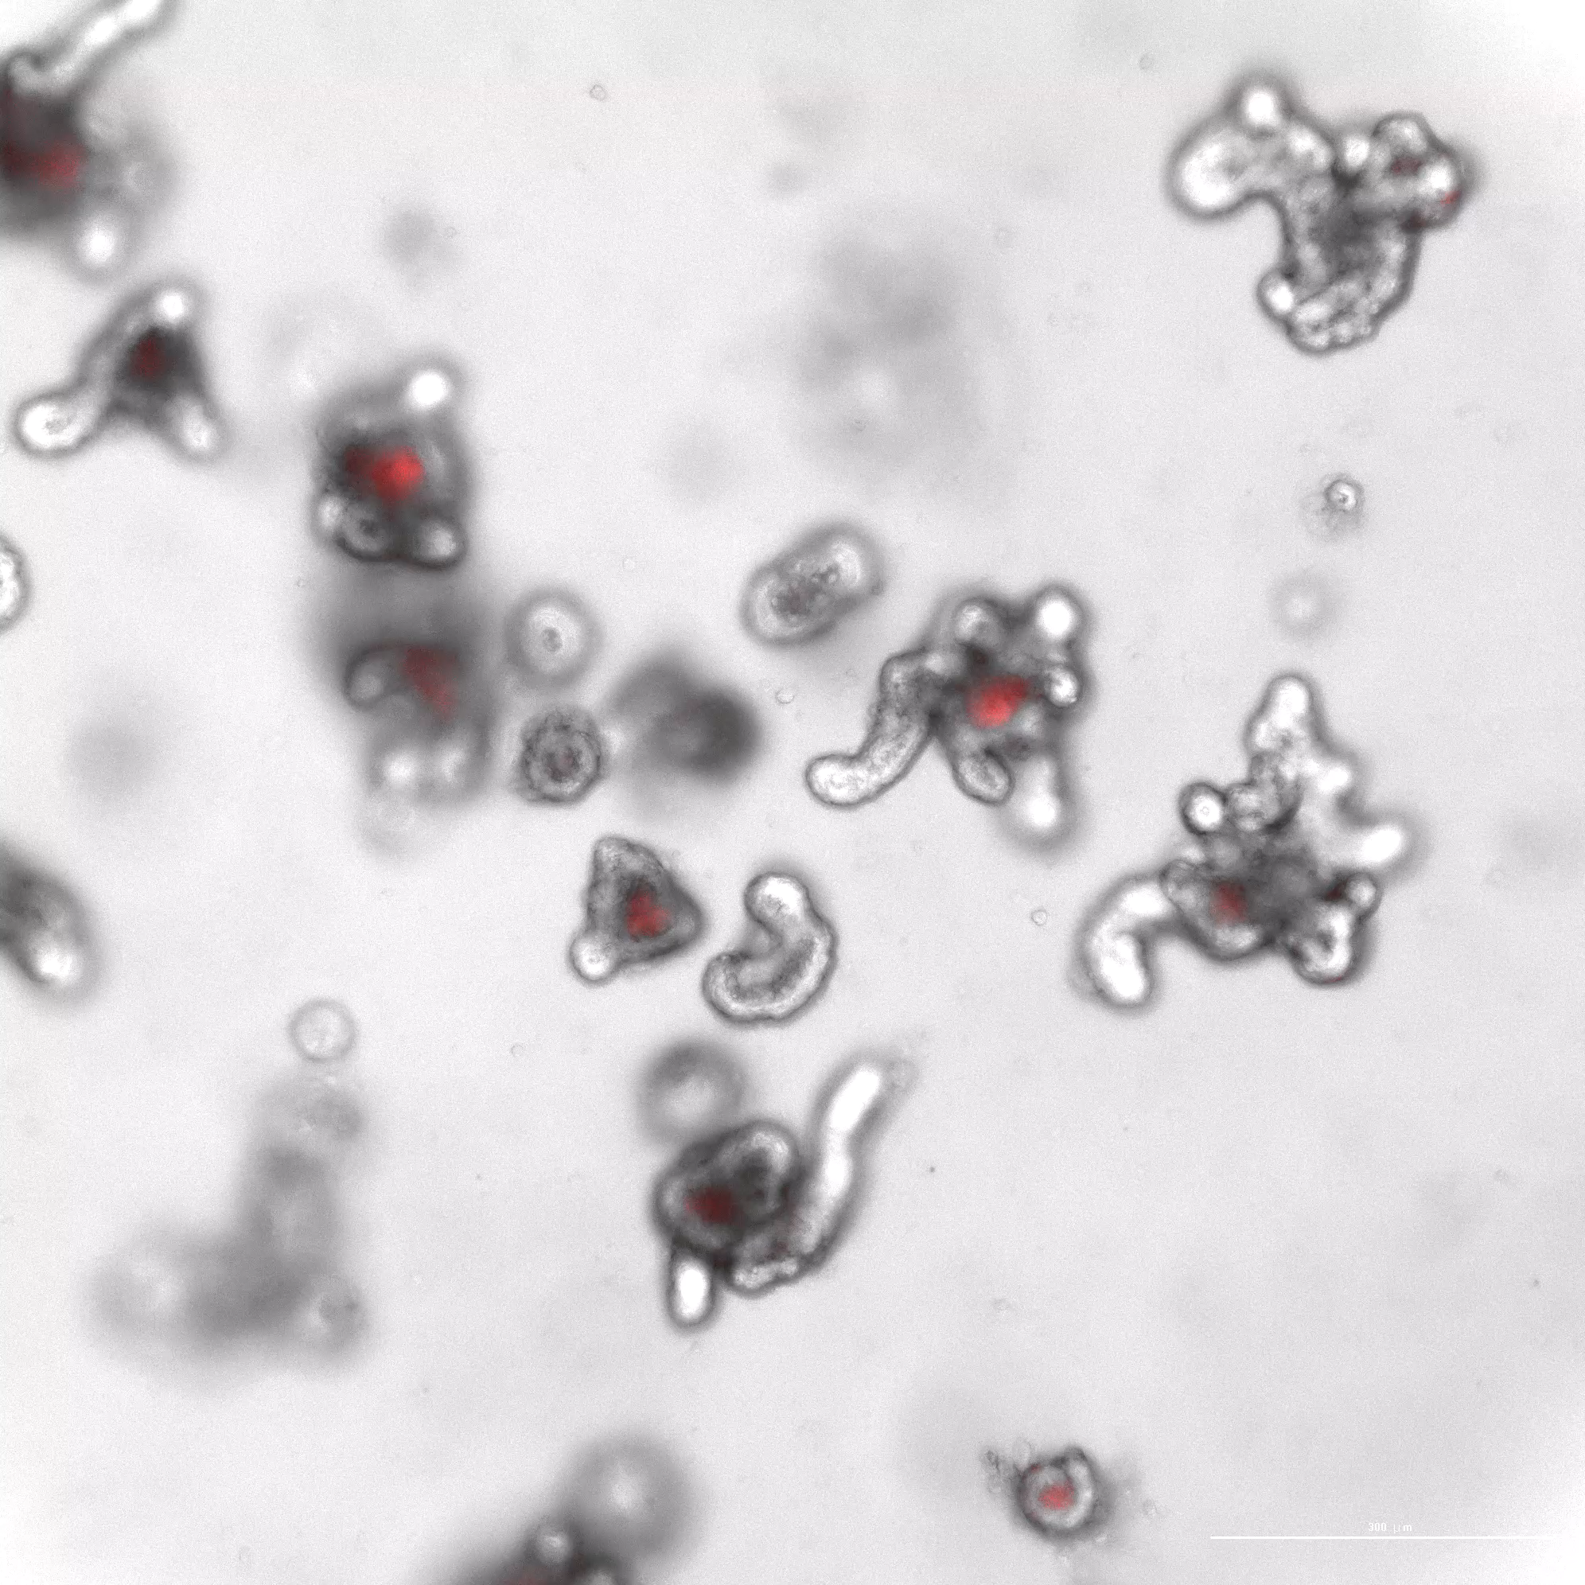
Fig. S9. Impact of META on intestinal organoids
c
Supplemental video
+ tBHP
Cont
tBHP
Blank-MS
META

